Slide 1

https://github.com/VanitaRawal/AIMLProject3
Project 3 (Object Detection using Yolov4)
Talent Sprint-IIIT Hyderabad

Slide 2
Introduction of Team members
Vanita
Works for Conduent and has
7 years of experience in Healthcare domain
Bharat
Works for Ericson as Senior Network Engineer has 7 years of experience in network
Manohar
Works as Mathematics teacher leading an academy

Slide 3
Title: Image tagging and road object detection Objective: Detect object tagging in the video and examine how parallel object detection on multiple patches can allow detection of smaller objects in the overall image without decreasing the resolution
Project Details
Project Details

Slide 4
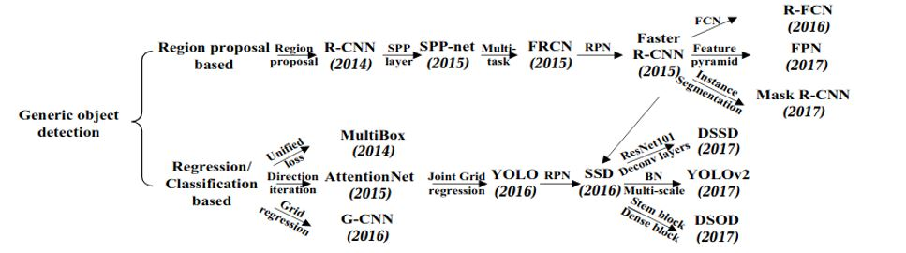
Types of Object Detection
Region proposal-based framework It is composed of 3 corelated stages, including region proposal generation, feature extraction with CNN, classification and bounding box regression, which are usually trained separately.
Regression/Classification Based Framework
One-step frameworks based on global regression/classification, mapping straight from image pixels to bounding box coordinates and class probabilities, can reduce time expense. Two significant frameworks, You look only Once (YOLO) & Single Shot Detector using multi-box(SSD)

Slide 5
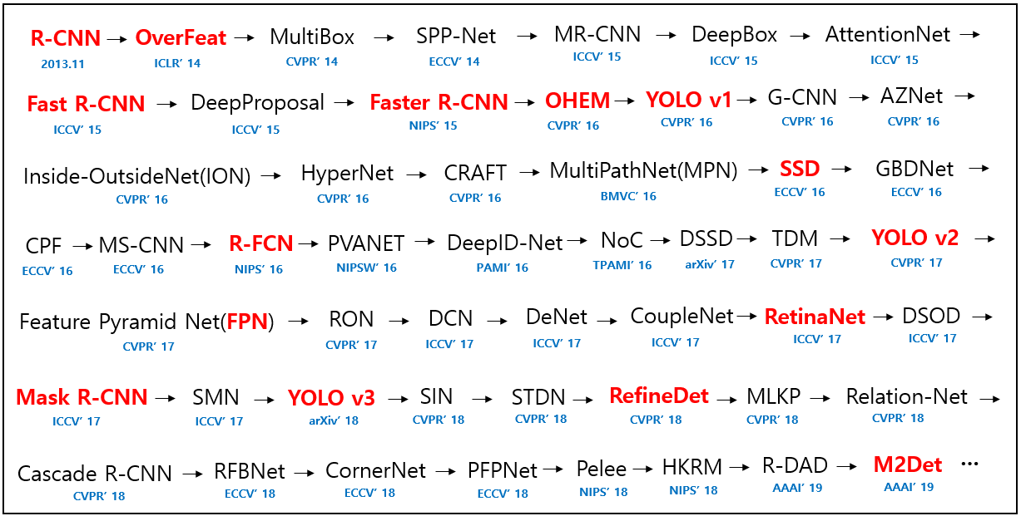
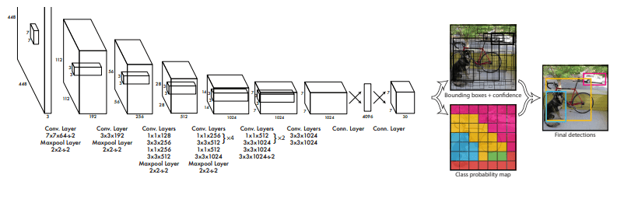
Link for all paper references: https://github.com/hoya012/deep_learning_object_detection
Recognised Papers & Algorithms Trends
Basic Architecture of YOLO
Image Reference :https://github.com/hoya012/deep_learning_object_detection

Slide 6
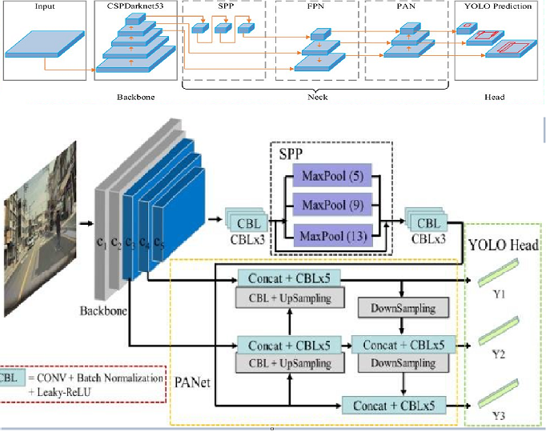
YOLOV4 understanding : https://becominghuman.ai/explaining-yolov4-a-one-stage-detector-cdac0826cbd7 YOLO understanding : shorturl.At/uxmy2
Summary of Papers/Versions of YOLO
Yolov4
Yolo9000-YOLOV2-YoloV3
The Original YOLO — YOLO was the first object detection network to combine the problem of drawing bounding boxes and identifying class labels in one end-to-end differentiable network.
YOLOv2 — YOLOv2 made a number of iterative improvements on top of YOLO including BatchNorm, higher resolution, and anchor boxes.
YOLOv3 — YOLOv3 built upon previous models by adding an abjectness score to bounding box prediction, added connections to the backbone network layers and made predictions at three separate levels of granularity to improve performance on smaller objects.
New architecture in Backbone. Bag of freebies Bag of specials CSPDarknet53

Slide 7
YOLO Architecture
The YOLO model is made up of three key components: the head, neck, and backbone.
The backbone is the part of the network made up of convolutional layers to detect key features of an image and process them. The backbone is first trained on a classification dataset, such as ImageNet, and typically trained at a lower resolution than the final detection model, as detection requires finer details than classification.
The neck uses the features from the convolution layers in the backbone with fully connected layers to make predictions on probabilities and bounding box coordinates.
The head is the final output layer of the network which can be interchanged with other layers with the same input shape for transfer learning. As discussed earlier, the head is an S × S × (C + B ∗ 5) tensor and is 7 × 7 × 30 in the original YOLO research paper with a split size S of 7, 20 classes C, and 2 predicted bounding boxes B.
These three portions of the model work together to first extract key visual features from the image then classify and bound them.

Slide 8
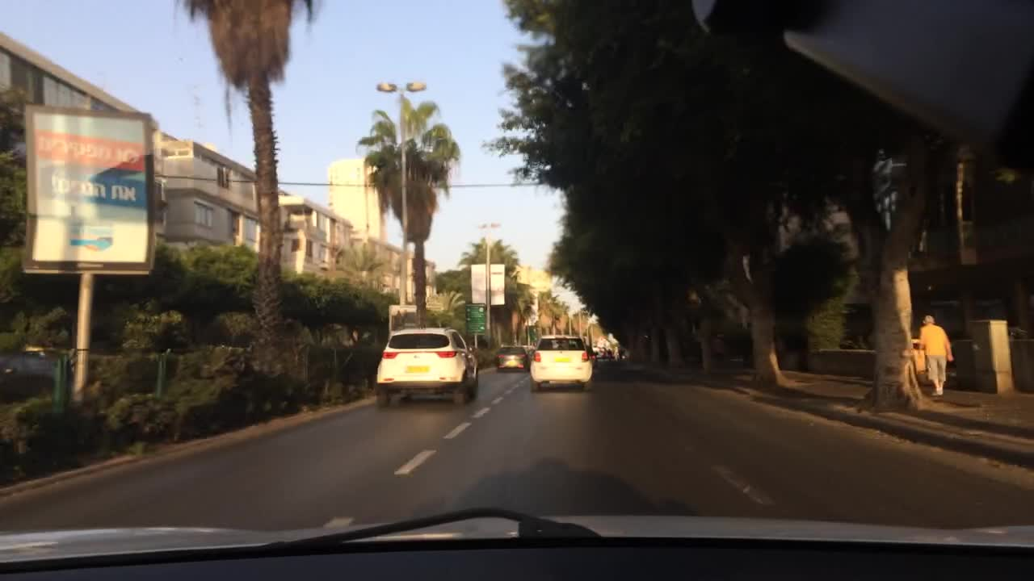
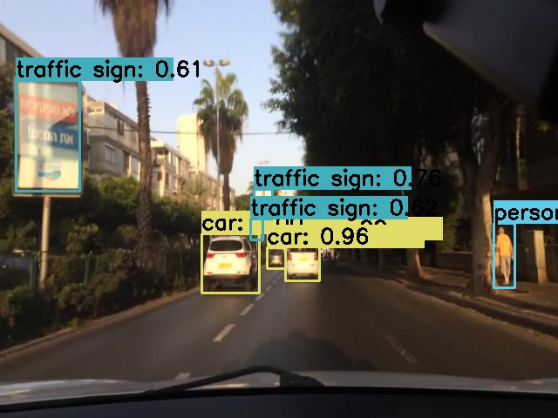
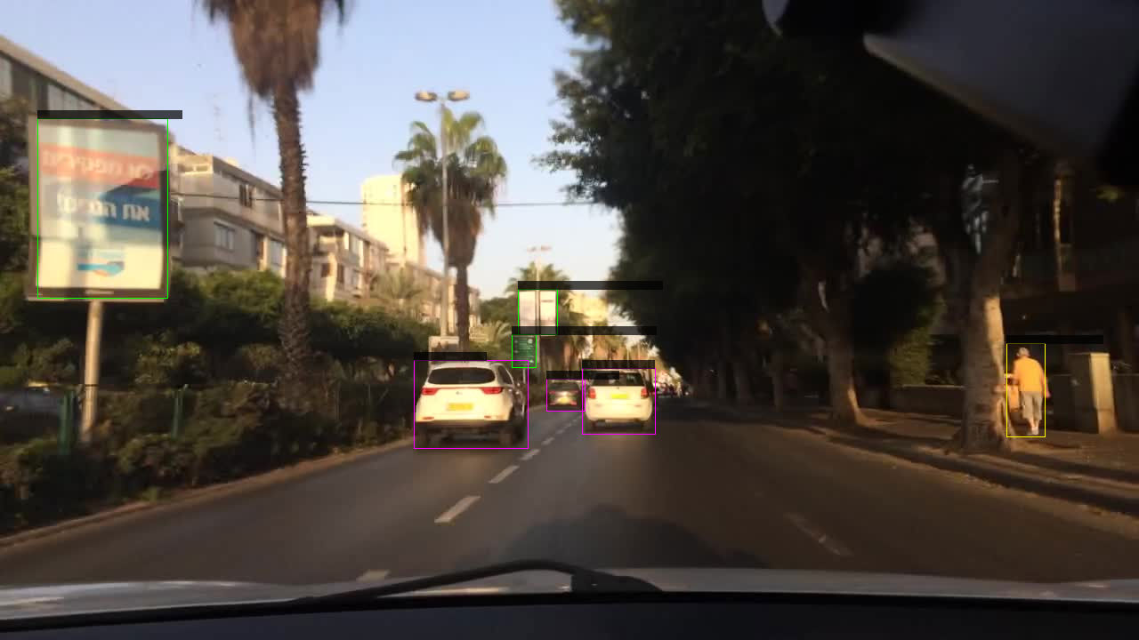
YOLO Neural Network
You Only Look Once (YOLO) only needs to process an image once to perform detection
A single neural network predicts bounding boxes and class probabilities
Can be optimized end-to-end directly on detection performance
Less computation, execution on PC with GPU card
Image-based algorithm suitable for safeguards surveillance camera data

Slide 9
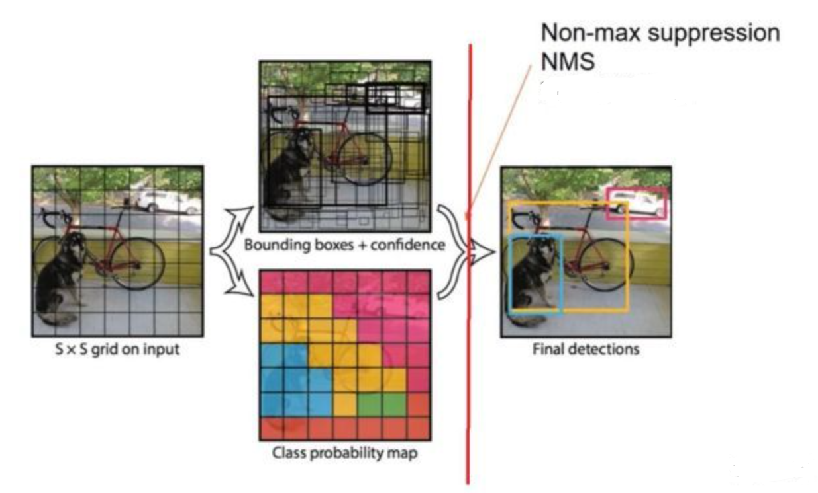
YOLOV4: Challenges & Parameters
Challenges
The fully connected network requires a fixed size, so we need to have a fixed size image, when detecting objects, we don’t necessarily have fixed size images. This problem forces us to scale the images, this method can remove a part of the object we want to detect and therefore decrease the accuracy of our model The second problem caused by CNN is that the size of the sliding window is fixed
Inference: Non-maximal suppression
Fixing duplicate detections
Remove detections with lower confidence score
Non-maximal suppression adds 2- 3% in mAP.

Slide 10
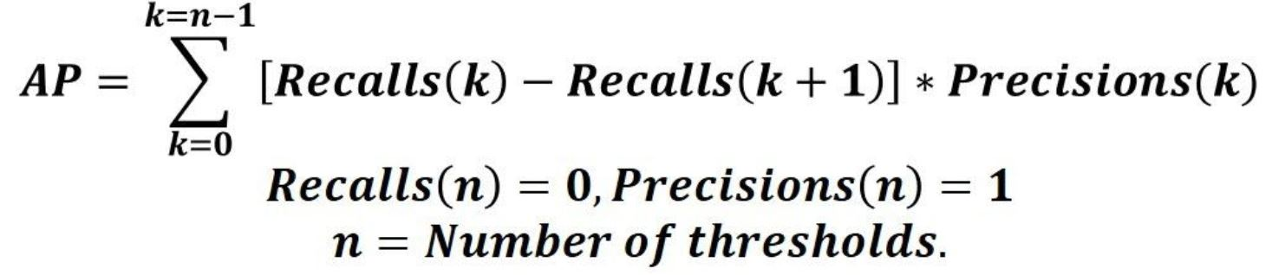
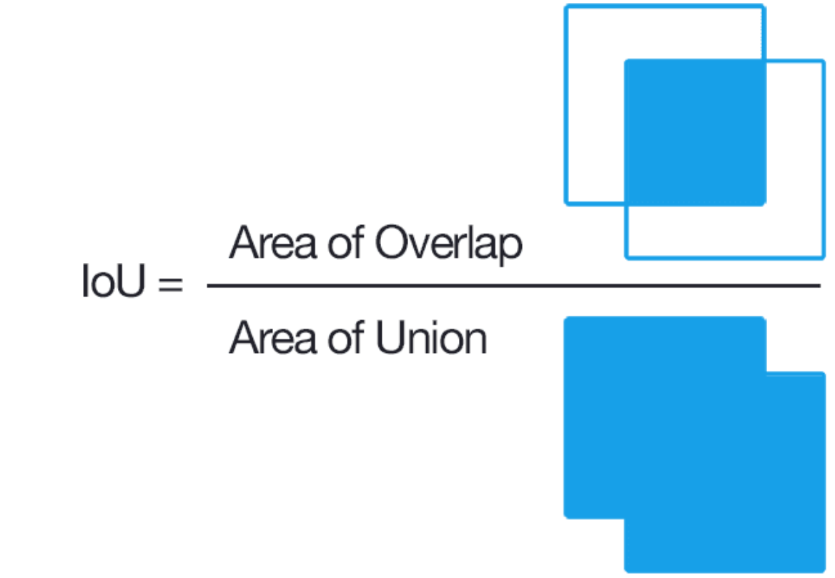
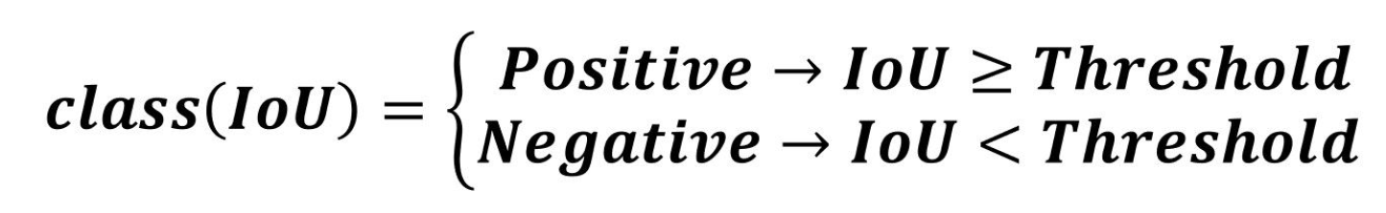
Performance parameters
Average Precision
AP@α is Area Under the Precision-Recall Curve(AUC-PR) evaluated at α IoU threshold. the AP is the weighted sum of precisions at each threshold where the weight is the increase in recall.
Intersection over Union (IoU) area of intersection divided by area of union between ground-truth and predicted box
Mean Average Precision (mAP) is the average of AP values over all classes
The precision-recall (PR) curve is a plot of precision and recall at varying values of confidence

Slide 11
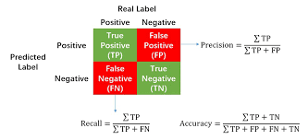

Slide 12
YOLOV4 advantages
Functional Improvements in YOLOv4:
It is twice as fast as in all parameters when compared to that of the existing competing object recognition models
Average Precision(AP) is a crucial parameter to measure the accuracy in the real-time object recognition is found to increase by 10% than the available models.
Frames Per Second(FPS) is to measure the speed and if found to be increased to 12% in YOLOv4 with that of the YOLOv3

Slide 13
YOLOV4 architecture terminology
Bag of freebies
Bag of freebies methods are the set of methods that only increase the cost of training or change the training strategy while leaving the cost of inference low.
Data Augmentation
Photometric Distortion
Geometric Distortion MixUp CutMix
Bag of specials
Bag of special methods are the set of methods which increase inference cost by a small amount but can significantly improve the accuracy of object detection.
Neck (Feature aggregator)
The essential role of the neck is to collect feature maps from different stages of backbone. Usually, a neck is composed of several bottom-up paths and several top-down paths.
Head (Object Detector)
It basically finds the region where the object might be present but doesn't talk about which object is present in that region. YOLOV4 has two-stage detectors and one stage-detectors which are further subdivided into anchor-based and anchor-free detectors

Slide 14
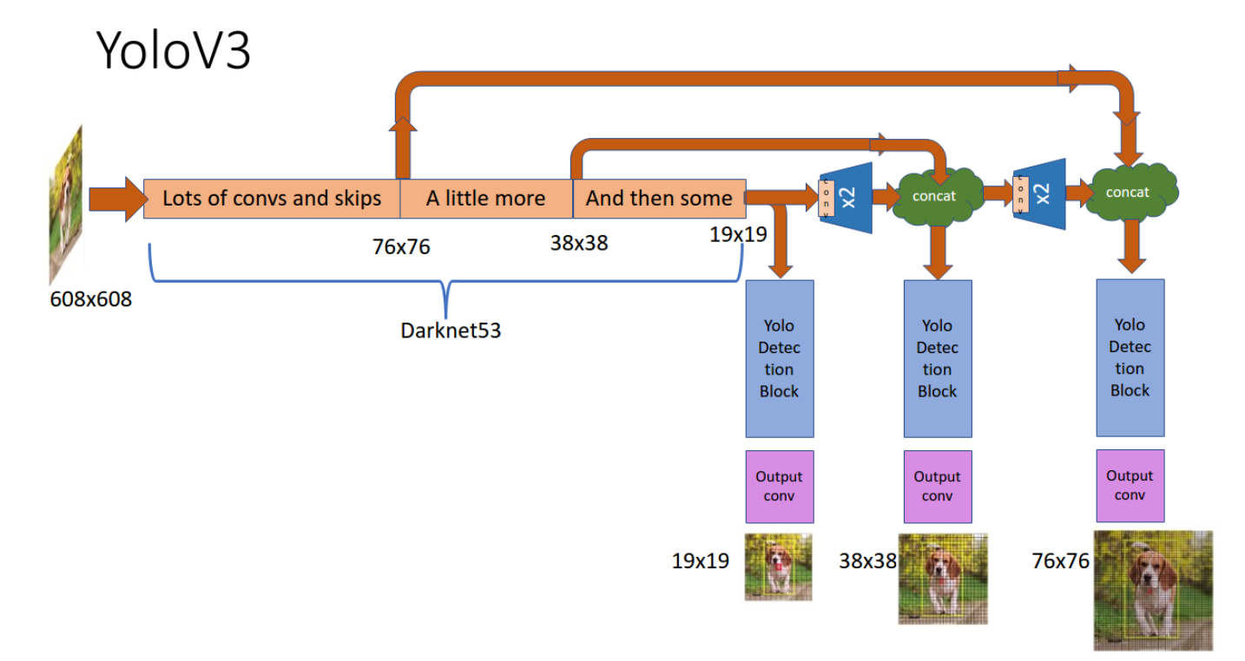
Inspired by ResNet and FPN (Feature-Pyramid Network) architectures, YOLO-V3 feature extractor, called Darknet-53 (it has 52 convolutions) contains skip connections (like ResNet) and 3 prediction heads (like FPN) — each processing the image at a different spatial compression
YOLO- three head Predictions

Slide 15
SPP (Spatial pyramid pooling)is a method of acquiring both fine and coarse information by simultaneously pooling on multiple kernel sizes (1,5,9,13) Spatial Pyramid Pooling Layer will allow to generate fixed size features whatever the size of our feature maps.
SPP can generate a fixed- length output regardless of the input size
SPP uses multi-level spatial bins, while the sliding window pooling uses only a single window size. Multi-level pooling has been shown to be robust to object deformations
SPP can pool features extracted at variable scales thanks to the flexibility of input scales
Information loss at different layers and PaNET (Path Aggregation Network)
Challenge : The early layers extract localized texture and pattern information to build up the semantic information needed in the later layers. However, as we progress to the right, localized information that may be needed to fine-tune the prediction may be lost.
YOLOV4 solution : the current layer and information from a previous layer is added together to form a new vector. In the YoloV4 implementation, a modified version is used where the new vector is created by concatenating the input and the vector from a previous layer
Reference : https://medium.com/aiguys/yolo-v4-explained-in-full-detail-5200b77aa825

Slide 16
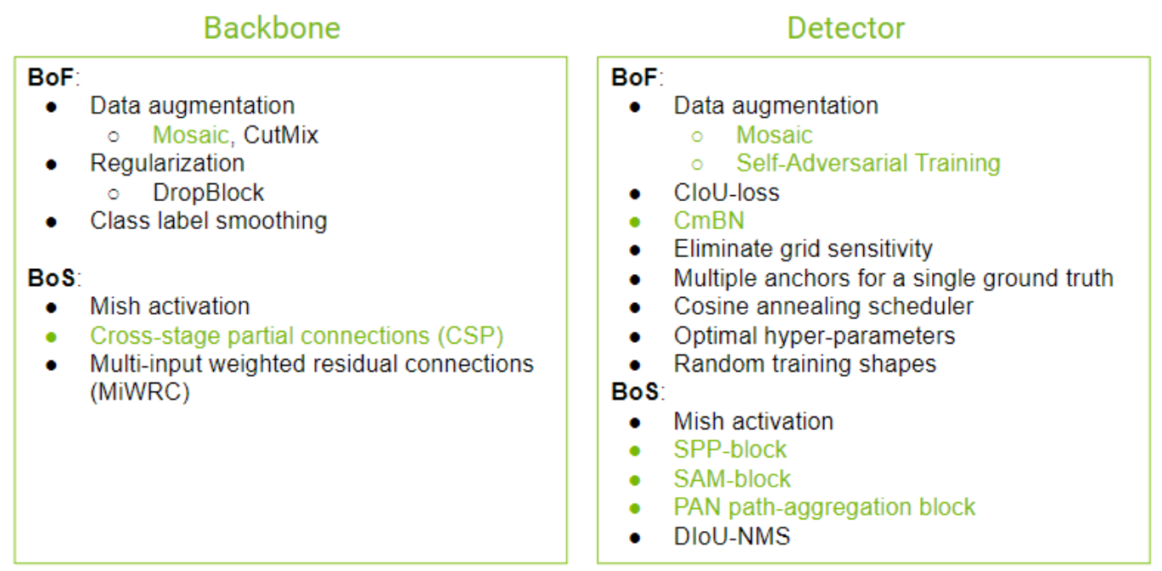
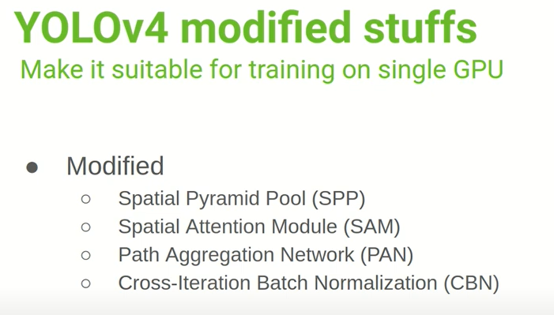
YOLOV4- (Modified Networks, BOF & BOS selection)
https://sh-tsang.medium.com/review-yolov4-optimal-speed-and-accuracy-of-object-detection-8198e5b37883

Slide 17
BDD100K Datasets
BDD 100K dataset description: the Berkeley deep drive (BDD) dataset is one of the largest and most diverse video and images datasets for autonomous vehicles.
● Dataset contains 100,000 images/videos collected from more than 50,000 rides covering New York, San Francisco bay area, and other regions.
● The dataset contains diverse scene types such as city streets, residential areas, and highways.
● Furthermore, the images were captured in diverse weather conditions at different times of the day

Slide 18
Model Performance
Model Training summary
detections_count = 973392, unique_truth_count = 183592
class_id = 0, name = car, ap = 71.81% (TP = 71890, FP = 29798)
class_id = 1, name = bus, ap = 62.16% (TP = 898, FP = 502)
class_id = 2, name = person, ap = 51.00% (TP = 6582, FP = 3873)
class_id = 3, name = bike, ap = 43.44% (TP = 345, FP = 399)
class_id = 4, name = truck, ap = 62.64% (TP = 2482, FP = 1511)
class_id = 5, name = motor, ap = 41.67% (TP = 150, FP = 131)
class_id = 6, name = train, ap = 1.11% (TP = 0, FP = 0)
class_id = 7, name = rider, ap = 40.07% (TP = 243, FP = 180)
class_id = 8, name = traffic sign, ap = 64.21% (TP = 21626, FP = 11412)
class_id = 9, name = traffic light, ap = 51.54% (TP = 16005, FP = 11089)
for conf_thresh = 0.25, precision = 0.67, recall = 0.65, F1-score = 0.66
for conf_thresh = 0.25, TP = 120221, FP = 58895, FN = 63371, average IoU = 51.27 %
IoU threshold = 50 %, used Area-Under-Curve for each unique Recall
mean average precision (mAP@0.50) = 0.489647, or 48.96 %
Total Detection Time: 3430 Seconds
Set -points flag:
`-points 101` for MS COCO
`-points 11` for PascalVOC 2007 (uncomment `difficult` in voc.data)
`-points 0` (AUC) for ImageNet, PascalVOC 2010-2012, your custom dataset
mean_average_precision (mAP@0.50) = 0.489647
New best mAP!
Saving weights to /content/gdrive/MyDrive/content/bdd100k/backup/Yolov4_tiny_changes_best.weights
Saving weights to /content/gdrive/MyDrive/content/bdd100k/backup/Yolov4_tiny_changes_20000.weights
Saving weights to /content/gdrive/MyDrive/content/bdd100k/backup/Yolov4_tiny_changes_last.weights
Saving weights to /content/gdrive/MyDrive/content/bdd100k/backup/Yolov4_tiny_changes_final.weights
If you want to train from the beginning, then use flag in the end of training command: -clear
Lowest AP is for class = 6, Train. Because of less number of training images
Best AP is for class =0 ,car. Highest number of BB for cars in all dataset MAP is 48.9%

Slide 19
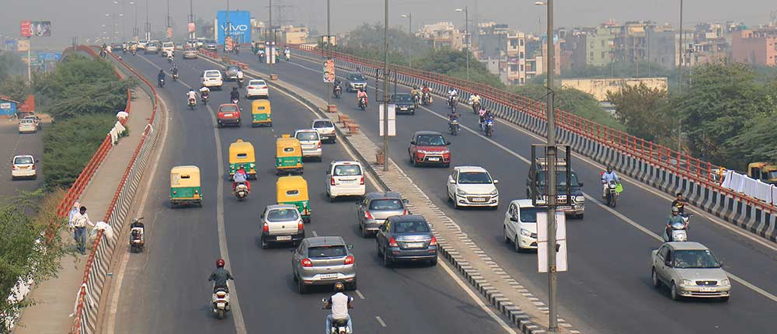
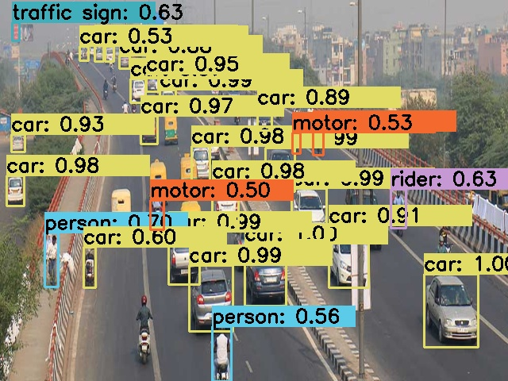
RESULTS on Indian road traffic image

Slide 20
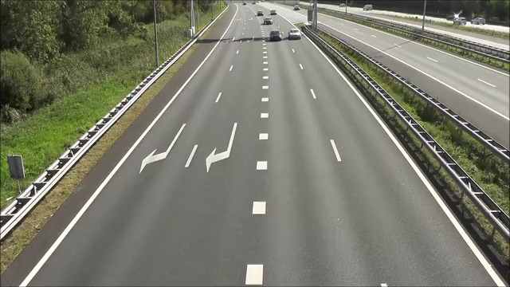
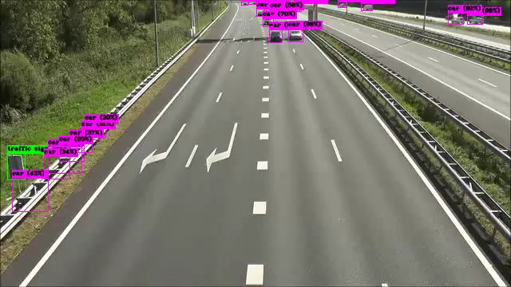
Input Video
Output Video file

Slide 21
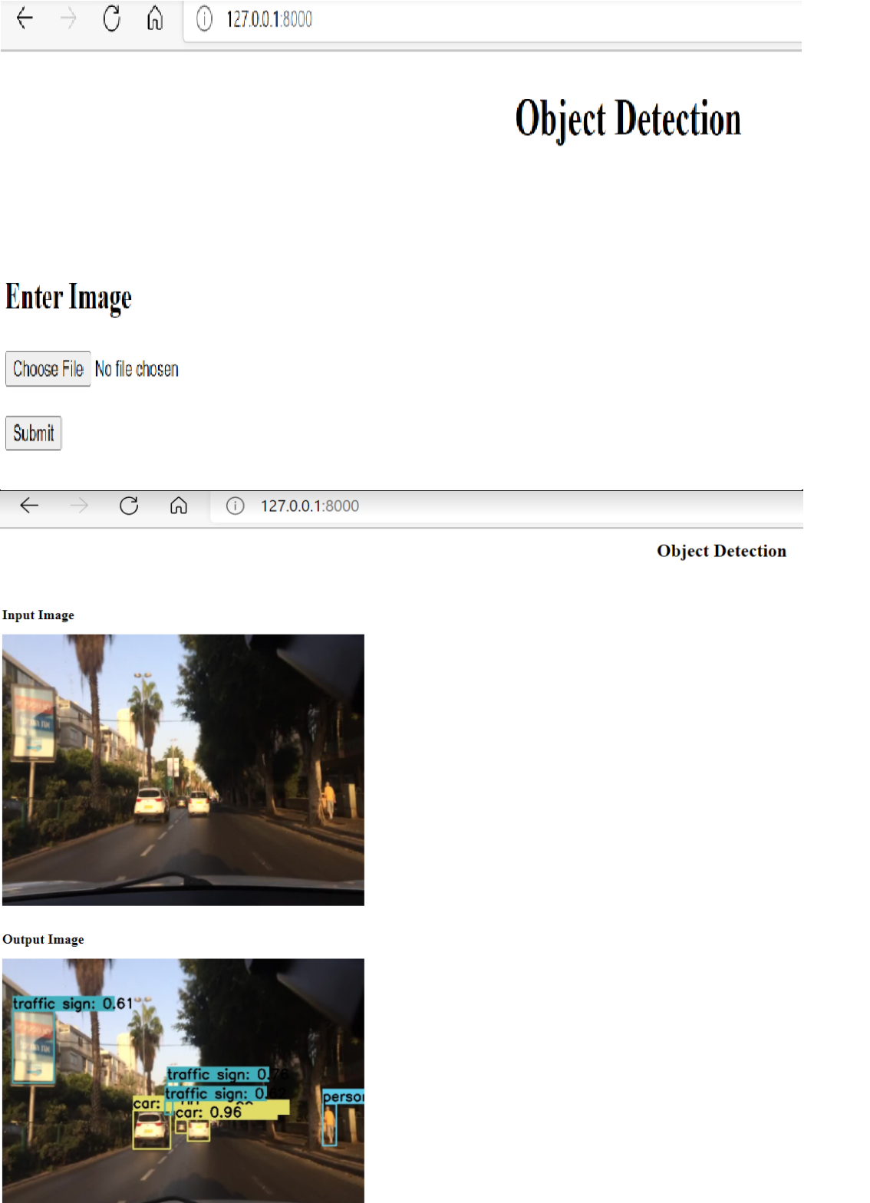
Local machine web deployment

Slide 22
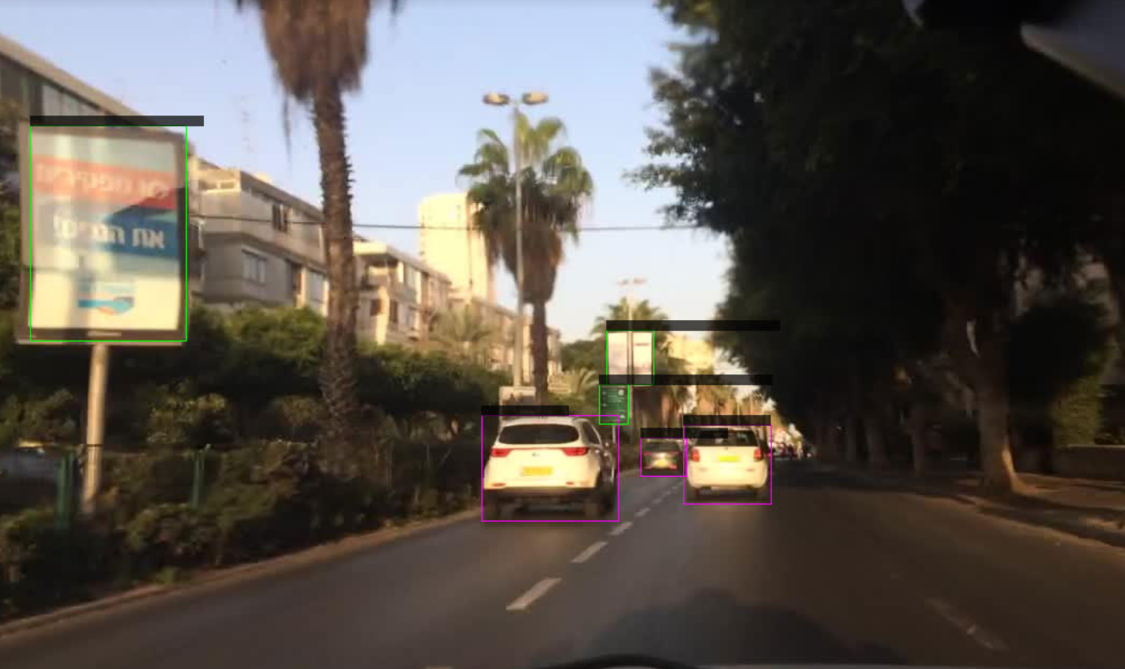
Issues Resolution
Project Challenges and solution
1- Gdrive memory size 2- Continuous availability of GPU 3- Confidence score was not readable
1- New Google account 2- Buy Google colab pro 3a- Set LIBSO=1 will create the shared library of the darknet, ‘libdarknet.so‘, which is used to interface darknet and Python.
3b- set GPU=1 and CUDNN=1 to speedup on GPU
set CUDNN_HALF=1 to further speedup 3 x times (Mixed-precision on Tensor Cores) GPU: Volta, Xavier, Turing and higher

Slide 23
Tools and Libraries used
Libraries used : numpy, cv2, FastAPI, Jinja2Templates
Tools Used: Google Colab-Pro, Visual Studio Code, Anaconda IDE
Language: HTML & Python
Web Server: Uvicorn FastAPI

Slide 24
Learnings
1- Learned YOLOV4 from starting 2- Now we know how to proceed with research paper and use transfer learning for problems 3- Data pipeline and labelled data plays an important role for any model prep 4- Complete model cycle 5- Data augmentation

Slide 25
Q & A ?

Slide 26


